Slide 3
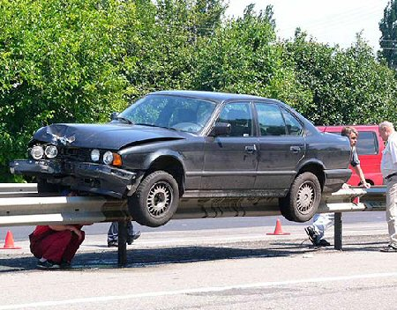
Guardrails
Hitting guardrails will cause some damage, but it keeps you from destroying your life

Slide 4
God’s guardrails
God’s guardrails keep us from ruining our lives

Slide 5
Guardrails Around Relationships

Slide 6
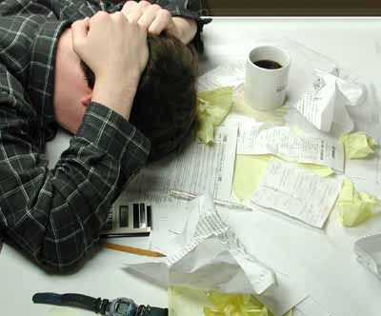
Guardrails Around Finances

Slide 7
Guardrails Around Our Attitudes
Attitude

Slide 8
Guardrails Around Purity

Slide 9
We look at one of the most serious guardrails of all
No one laughs about moral failures
The crash that happens after a moral failure is one of the hardest to recover from

Slide 10
Hebrews 7:26-27
For it was fitting for us to have such a high priest, holy, innocent, undefiled, separated from sinners and exalted above the heavens; who does not need daily, like those high priests, to offer up sacrifices, first for His own sins and then for the sins of the people, because this He did once for all when He offered up Himself.

Slide 11
Hebrews 7:26-27
For it was fitting for us to have such a high priest, holy, innocent, undefiled, separated from sinners and exalted above the heavens; who does not need daily, like those high priests, to offer up sacrifices, first for His own sins and then for the sins of the people, because this He did once for all when He offered up Himself.

Slide 12
Hebrews 7:26-27
For it was fitting for us to have such a high priest, holy, innocent, undefiled, separated from sinners and exalted above the heavens; who does not need daily, like those high priests, to offer up sacrifices, first for His own sins and then for the sins of the people, because this He did once for all when He offered up Himself.

Slide 13
Hebrews 7:26-27
For it was fitting for us to have such a high priest, holy, innocent, undefiled, separated from sinners and exalted above the heavens; who does not need daily, like those high priests, to offer up sacrifices, first for His own sins and then for the sins of the people, because this He did once for all when He offered up Himself.

Slide 14
1 Peter 1:16 Be holy as He is holy… because it is written, “YOU SHALL BE HOLY, FOR I AM HOLY.”

Slide 15
God’s guardrails
God has multiple guardrails around purity

Slide 16
The Bible is filled with examples, both good and bad, that we need to take to heart
Amnon whose lust for his sister was so great that he raped her
Joseph who was seduced by his boss’s wife
David’s affair with Bathsheba
The homosexuals pounding on Lot’s door
Samson and his relationships with Philistine women

Slide 17
Guardrail #1 Watch where you park your brain
Mark 7:20-21 And He was saying, “That which proceeds out of the man, that is what defiles the man. For from within, out of the heart of men, proceed the evil thoughts, fornications, thefts, murders, adulteries,”
Moral failures do not begin in the bedroom…they begin in the brain

Slide 18
Col 3:16 Let the word of Christ richly dwell within you, with all wisdom teaching and admonishing one another with psalms and hymns and spiritual songs, singing with thankfulness in your hearts to God.
Phil 4:8 Finally, brethren, whatever is true, whatever is honorable, whatever is right, whatever is pure, whatever is lovely, whatever is of good repute, if there is any excellence and if anything worthy of praise, let your mind dwell on these things.

Slide 19
Prov 7:7 And I saw among the naïve, I discerned among the youths, a young man lacking sense
This lack of sense leads to two problems
1. We underestimate the power of lust
2. We overestimate our ability to resist

Slide 20
Guardrail #1 Watch where you park your brain
1. If you don’t want to mess up morally, then don’t get in situations that are going to put that in your head.
Moral failures do not begin in the bedroom…they begin in the brain

Slide 21
If you are hanging with people who have no problems removing God’s stop signs…you are bound to go off the edge…it will happen!

Slide 22
Guardrail #1 Watch where you park your brain
1. If you don’t want to mess up morally, then don’t get in situations that are going to put that in your head.
Moral failures do not begin in the bedroom…they begin in the brain
2. What are you putting in your brain?

Slide 23
Prov 4:23 “Guard your heart above all else, for it determines the course of your life”
Ps 51:10 “Create in me a pure heart”

Slide 24
When you say, “I do,” that implies I do things…it also implies, “I don’t” do things
1. You don’t spend time alone with someone of the opposite sex that you’re not married to (that includes social medias)
2. You don’t pour your soul out to the opposite sex that you’re not married to

Slide 25
When you say, “I do,” that implies I do things…it also implies, “I don’t” do things
3. You don’t ever go to the home of the opposite sex alone--NEVER
4. You don’t hide things from your mate

Slide 26
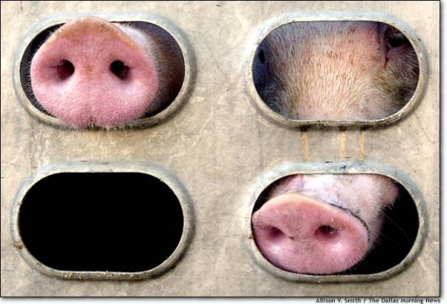
As an Ox going to the slaughter
As a bird that hastens to the snare
He does not know that it will cost him his life
Each animal was caught off guard
Each animal was killed

Slide 27
Guardrail #1 Watch where you park your brain
Mark 7:20-21 And He was saying, “That which proceeds out of the man, that is what defiles the man. For from within, out of the heart of men, proceed the evil thoughts, fornications, thefts, murders, adulteries,”
Moral failures do not begin in the bedroom…they begin in the brain

Slide 28
Guardrail #2 God has a fence around intimacy. Don’t you dare climb over

Slide 29
Gen 39:11-12 Now it happened one day that he went into the house to do his work, and none of the men of the household was there inside. She caught him by his garment, saying, ‘Lie with me!’ And he left his garment in her hand and fled, and went outside.”
2 Tim 2:22 Flee youthful lusts
1 Cor 6:18 Flee fornication…

Slide 30
Sexual Activity Outside of Marriage is Wrong
Heb 13:4 Let marriage be held in honor among all, and let the marriage bed be undefiled; for fornicators and adulterers God will judge.

Slide 31
Sexual Activity Outside of Marriage is Wrong
Rom. 13:13 Let us behave properly as in the day, not in carousing and drunkenness, not in sexual promiscuity and sensuality, not in strife and jealousy.

Slide 32
Sexual Activity Outside of Marriage is Wrong
Gal 5:19, 21 Now the works of the flesh are manifest, which are these; Adultery, fornication, uncleanness, lasciviousness, envyings, murders, drunkenness, revellings, and such like: of the which I tell you before, as I have also told you in time past, that they which do such things shall not inherit the kingdom of God.

Slide 33
Sexual Activity Outside of Marriage is Wrong
Col 3:5, 6 Therefore consider the members of your earthly body as dead to immorality, impurity, passion, evil desire, and greed, which amounts to idolatry. For it is on account of these things that the wrath of God will come,

Slide 34
Sexual Activity Outside of Marriage is Wrong
1 Thes 4:4,5 that each of you know how to possess his own vessel in sanctification and honor, not in lustful passion, like the Gentiles who do not know God;

Slide 35
Sexual Activity Outside of Marriage is Wrong
Rev 22:15 Outside are the dogs and the sorcerers and the immoral persons and the murderers and the idolaters, and everyone who loves and practices lying.

Slide 36
Guardrail # 3 You can be pure, even in this impure world
Philippians 2:15 “so that you will prove yourselves to be blameless and innocent, children of God above reproach in the midst of a crooked and perverse generation, among whom you appear as lights in the world”

Slide 37
God expects you to be salt and light
1 Timothy 2:10
but rather by means of good works, as is proper for women making a claim to godliness.
Ephesians 4:1
Therefore I, the prisoner of the Lord, implore you to walk in a manner worthy of the calling with which you have been called,

Slide 38
Help your mate
Be transparent in your feelings
Be the veto vote
Protect your marriage at all costs

Slide 39
Guardrail # 4 The Impure can be pure in Christ

Slide 40
Fornication doesn’t happen because you don’t love God
Fornication doesn’t happen because you didn’t know it was wrong

Slide 41
1 Corinthians 6:9-11
Or do you not know that the unrighteous will not inherit the kingdom of God? Do not be deceived; neither fornicators, nor idolaters, nor adulterers, nor effeminate, nor homosexuals, nor thieves, nor the covetous, nor drunkards, nor revilers, nor swindlers, will inherit the kingdom of God. Such were some of you; but you were washed, but you were sanctified, but you were justified in the name of the Lord Jesus Christ and in the Spirit of our God.

Slide 42
Guardrails Around Purity

